Slide 1
CST8333 Assignment 1
Space guy: Blockade – arcade style space shooter
Andrew Gaal
February 10, 2022

Slide 2
Introduction
Assignment 1 and 2 completed and approved
Some delays were encountered due to external obligations
Accomplishments:
60% of Source Code completed
Implemented basic menu and game scenes
Playable demo completed
Requirements Completed:
Scene Management system
Functional UI Buttons
Mouse controlled player
Various enemy objects with different behaviours
Functional hitboxes and destruction for player and enemies
Life and score counter UI elements
Game over condition
Sound effects
Requirements Outstanding:
High score scene
Pause and options menus
Enemy hit points (all enemies currently destroyed in one hit)
More complex enemy spawning mechanics (squadrons, bosses, etc.)
Animated sprites
Music

Slide 3
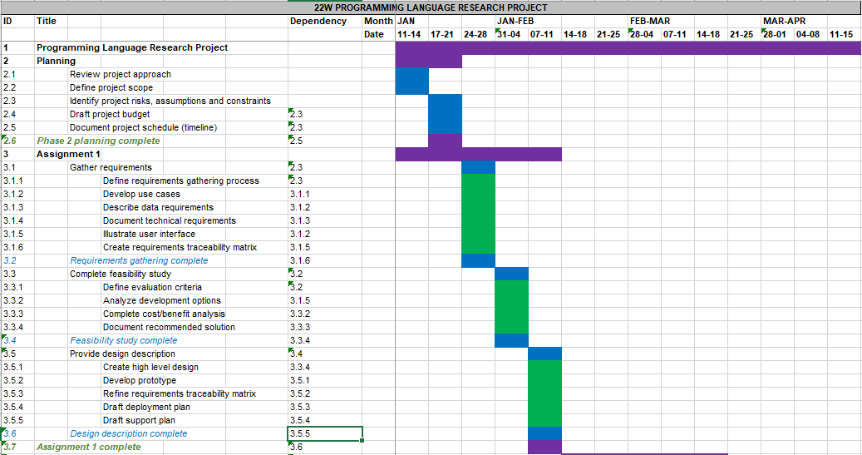
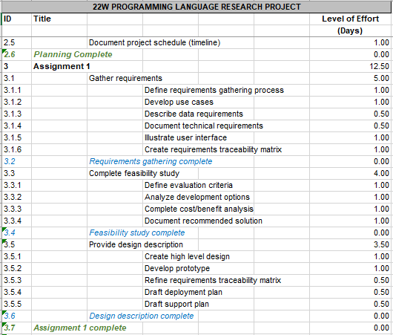
Details – Timeline & Budget
Timeline
The project is proceeding well, but behind schedule. Schedule slippage occurred as a result of external obligations on the developer’s part. Efforts will be made to bring the project back on schedule in Phase 3.
Budget
The budget is based on level of effort rather than financial input. Thus far, budget estimates have been accurate.

Slide 4
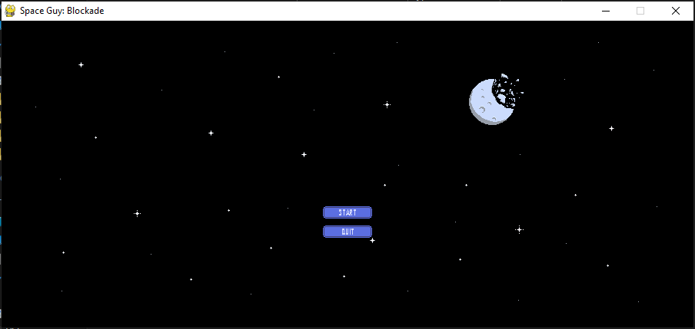
Details – Source Code
Programming Language: Python
Python was selected for the development of this project due to it’s popularity with employers and it’s extensive community support. Since I was largely unfamiliar with the language at the beginning of this project, it also served to provide the greatest opportunity for learning and personal growth.
In addition, the popular PyGame library was used as a game engine to facilitate development. While this meant reworking a fair amount of the architecture proposed in the last presentation, it has proven to be an enormous boon to development since it includes many classes and functionalities analogous to those originally proposed, and would otherwise have had to be written from scratch.
Stand-Alone Program Implementation
Since Python is typically used as a server-side scripting language for web applications, additional packaging tools were required to release the game as a stand-alone application. PyInstaller was selected for this purpose and has proven to function well.
For this reason, I have been able to include a playable demo with this assignment. It can be played by extracting the Space Guy.zip archive to a convenient directory and launching Space Guy.exe.

Slide 5
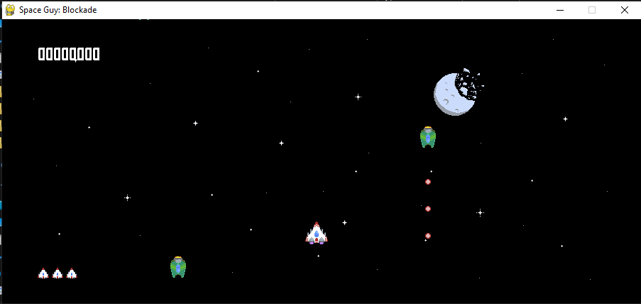
Conclusion
Phase 2, Source Code Implementation, is now complete.
60% of the source code has been completed, and 100% is scheduled to be completed by the end of Phase 3.
Further changes to project requirements will be tracked and mapped onto the Requirements Traceability Matrix, which will serve as the basis of system testing in Phase 3.

